Slide 1

Saloon Shop Performance Analysis Python Project
Vinay A. Dandekar
© All rights reserved by Fireblaze Technologies Pvt. Ltd.

Slide 2
Introduction
The Hair Saloon Customer Analysis project was created to study customer behavior, spending patterns, and loyalty at a local salon. The dataset includes details like age, gender, visit frequency, type of service, spending per visit, total spend, loyalty program participation, promotional response, and feedback scores.
Through this project, I learned how to segment customers based on spending, visits, and loyalty, analyze their value using RFM scores, and measure the impact of promotions and loyalty programs. This helped me understand how data analysis can identify high-value customers, improve customer retention, and support better marketing and personalized services.
© All rights reserved by Fireblaze Technologies Pvt. Ltd.

Slide 3
Dataset Description
The dataset includes Columns :
Age & Gender : Basic demographic details of the customers.
Visit_Frequency & Visit_Frequency_Group : Number of times a customer visits and their categorized frequency group.
Service_Type : Type of service taken such as haircut, coloring, or treatment.
Average_Spend_Per_Visit & Total_Spend : Customer’s spending per visit and overall spending at the salon.
Loyalty_Program : Whether the customer is enrolled in the salon’s loyalty program.
Promotional_Response : Customer’s response to special offers and promotions.
Feedback_Score : Rating or feedback given by the customer.
Age_Group : Categorized age groups like adult, middle age, or senior.
Customer_Value : Segmentation of customers as high, medium, or low value.
© All rights reserved by Fireblaze Technologies Pvt. Ltd.

Slide 4
Problem Statement
A customer’s engagement and value to a hair salon depend on several factors:
Demographics (Age, Gender, Age Group)
Visit behavior (Visit Frequency, Service Type, Visit Frequency Group)
Spending patterns (Average Spend per Visit, Total Spend)
Loyalty and promotions (Loyalty Program, Promotional Response)
Feedback and satisfaction (Feedback Score)
Salon owners cannot easily identify which customers are high-value, loyal, or at risk just by looking at raw data.
This project aims to build an analytical model using these features to segment customers, understand their behavior, measure loyalty, and provide actionable insights for better marketing, retention, and personalized services.
© All rights reserved by Fireblaze Technologies Pvt. Ltd.

Slide 5
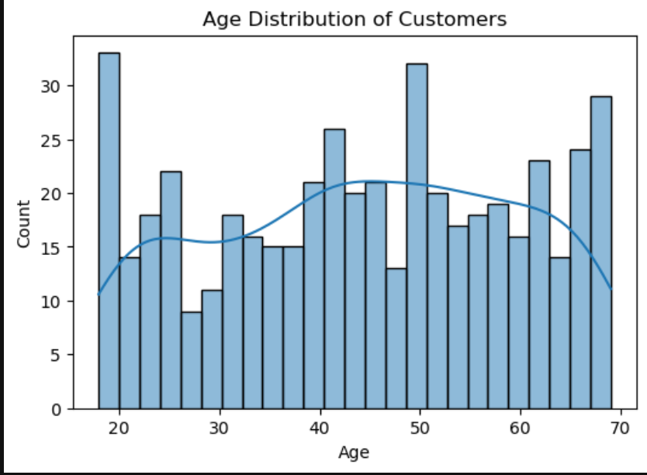
Customer Segmentation Insights
Code :
plt.figure(figsize=(6,4))
sns.histplot(data['Age'], bins =25 ,kde=True)
plt.title("Age Distribution of Customers")
plt.show()
© All rights reserved by Fireblaze Technologies Pvt. Ltd.

Slide 6
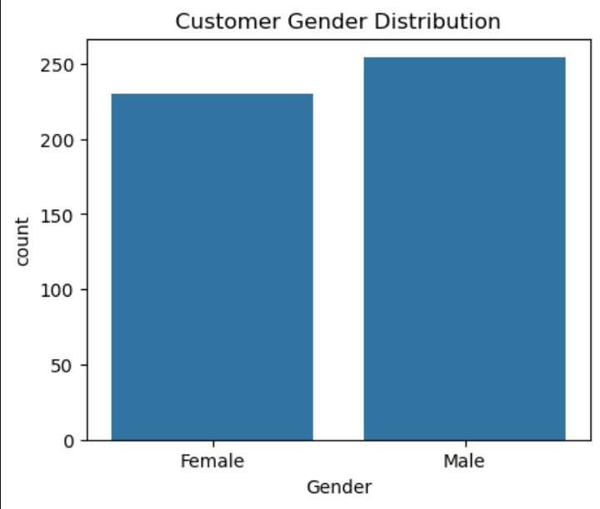
2. Customer Segmentation Insights: Gender distribution
Code :
# Gender distribution
plt.figure(figsize=(5,4))
sns.countplot(x='Gender', data=data )
plt.title("Customer Gender Distribution")
plt.show()
© All rights reserved by Fireblaze Technologies Pvt. Ltd.

Slide 7
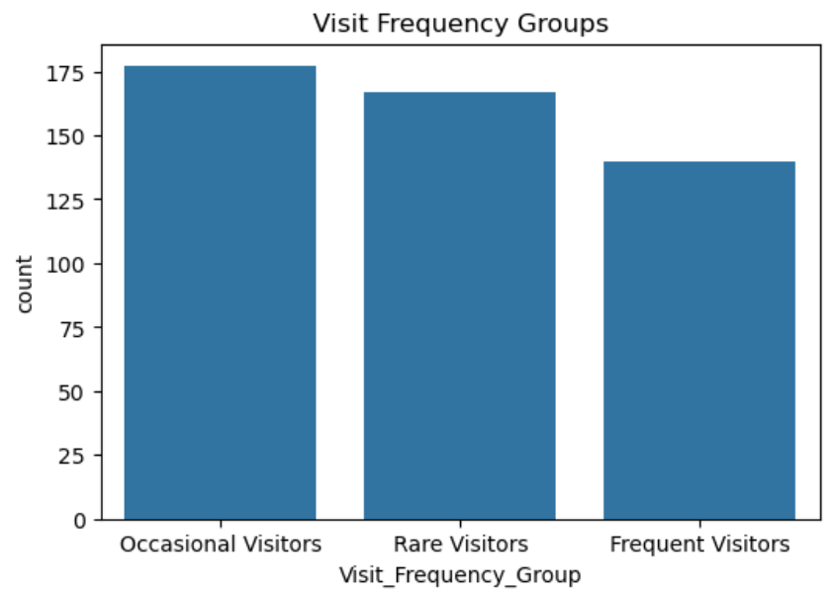
3. Customer Segmentation Insights: Visit Frequency Groups
Code :
#Visit Frequency Groups
plt.figure(figsize=(6,4))
sns.countplot(x='Visit_Frequency_Group’,
data=data,order=data['Visit_Frequency_Group’]
.value_counts().index)
plt.title("Visit Frequency Groups")
plt.show()
© All rights reserved by Fireblaze Technologies Pvt. Ltd.

Slide 8
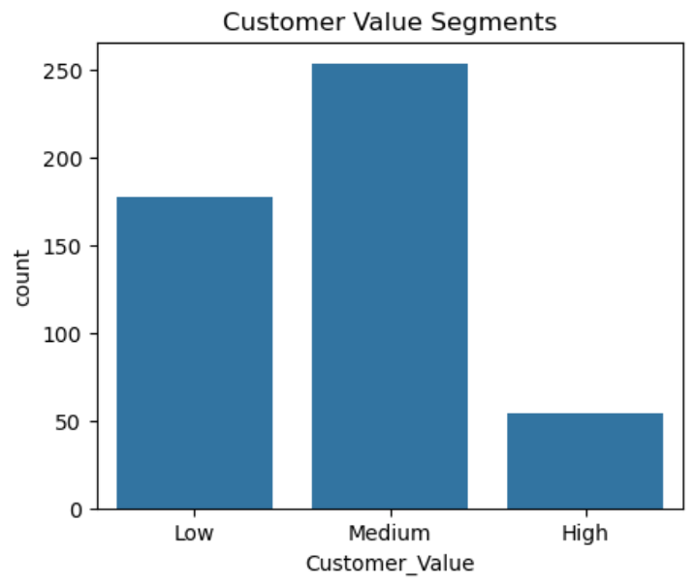
4. Customer Segmentation Insights: Customer Value distribution
Code :
# Customer Value distribution
plt.figure(figsize=(5,4))
sns.countplot(x='Customer_Value', data=data,
order=['Low', 'Medium', 'High’])
plt.title("Customer Value Segments")
plt.show()
© All rights reserved by Fireblaze Technologies Pvt. Ltd.

Slide 9
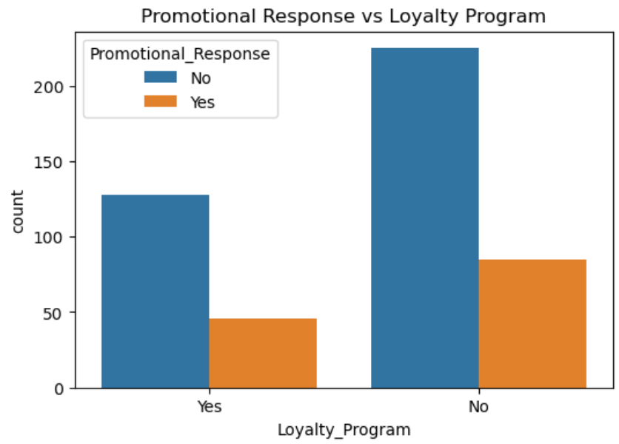
4. Promotion & Loyalty Insights: Customer Value distribution
Code :
plt.figure(figsize=(6,4))
sns.countplot(x='Loyalty_Program’,
hue='Promotional_Response', data=data)
plt.title("Promotional Response vs Loyalty Program")
plt.show()
© All rights reserved by Fireblaze Technologies Pvt. Ltd.

Slide 10
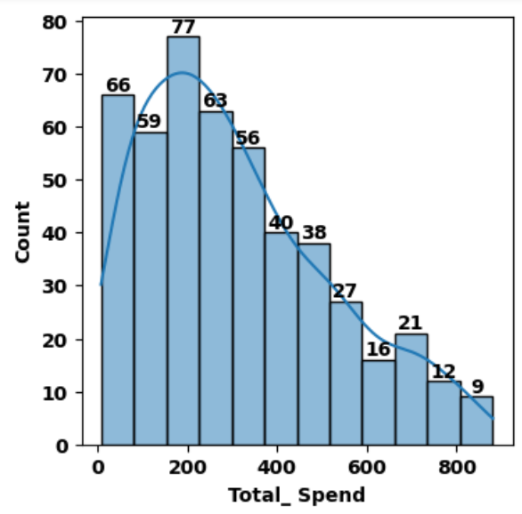
4. Promotion & Loyalty Insights:
Code :
plt.figure(figsize = (4,4))
A = sns.histplot(data = df , x ='Total_Spend',kde = True )
for i in A.containers:
A.bar_label(i,fontweight = "bold", c = "k")
plt.xticks(rotation = 0,fontweight = "bold")
plt.yticks(rotation = 0,fontweight = "bold")
plt.xlabel("Total_ Spend", fontweight = "bold", c = "k")
plt.ylabel("Count", fontweight = "bold", c = "k")
plt.show()
© All rights reserved by Fireblaze Technologies Pvt. Ltd.

Slide 11
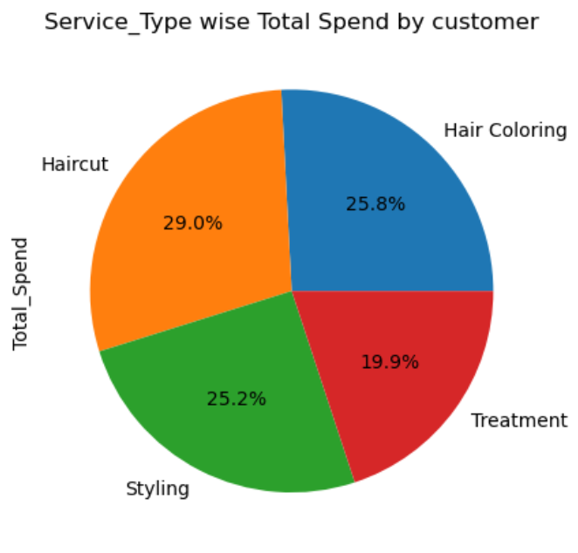
5. Service_Type wise Total Spend by customer
Code :
df.groupby("Service_Type")['Total_Spend'].sum()
.plot(kind="pie",autopct= "%0.1f%%")
plt.title("Service_Type wise Total Spend by customer")
plt.show()
© All rights reserved by Fireblaze Technologies Pvt. Ltd.

Slide 12
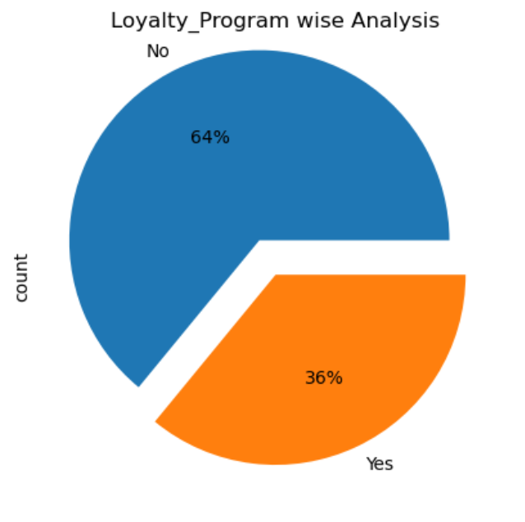
6. Loyalty_Program wise Analysis
Code :
df["Loyalty_Program"].value_counts()
.plot(kind = 'pie', autopct = '%.0f%%', explode = [0.2,0])
plt.title("Loyalty_Program wise Analysis")
© All rights reserved by Fireblaze Technologies Pvt. Ltd.

Slide 13
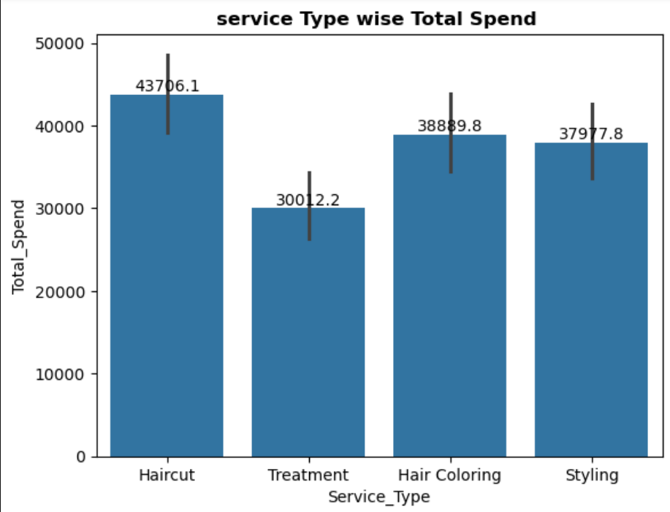
8. service Type wise Total Spend
Code :
A = sns.barplot(data = df , x = 'Service_Type’,
y = 'Total_Spend' , estimator='sum’)
for i in A.containers:
A.bar_label(i)
plt.title("service Type wise Total Spend “
,fontweight = "bold")
© All rights reserved by Fireblaze Technologies Pvt. Ltd.

Slide 14
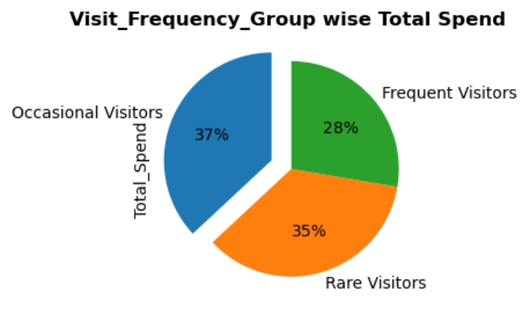
9. Visit_Frequency_Group wise Total Spend
Code :
explode=[0.2,0,0]
df.groupby("Visit_Frequency_Group")["Total_Spend"]
.sum().sort_values(ascending = False )
.plot(kind = 'pie',explode = explode ,
startangle=90, autopct = "%.0f%%")
plt.title("Visit_Frequency_Group wise Total Spend “
, fontweight = 'bold’)
plt.show()
© All rights reserved by Fireblaze Technologies Pvt. Ltd.

Slide 15
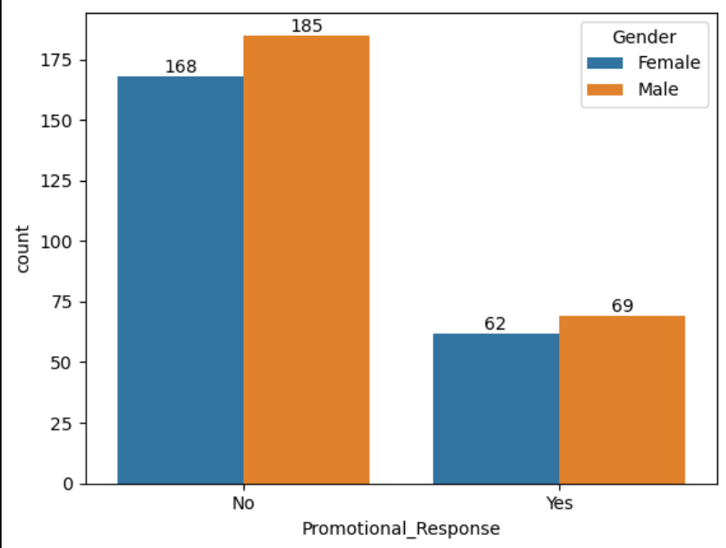
10. Gender wise Promotional_Response
Code :
A=sns.countplot(data=df,
x="Promotional_Response“
,hue = "Gender" )
for i in A.containers:
A.bar_label(i)
© All rights reserved by Fireblaze Technologies Pvt. Ltd.

Slide 16
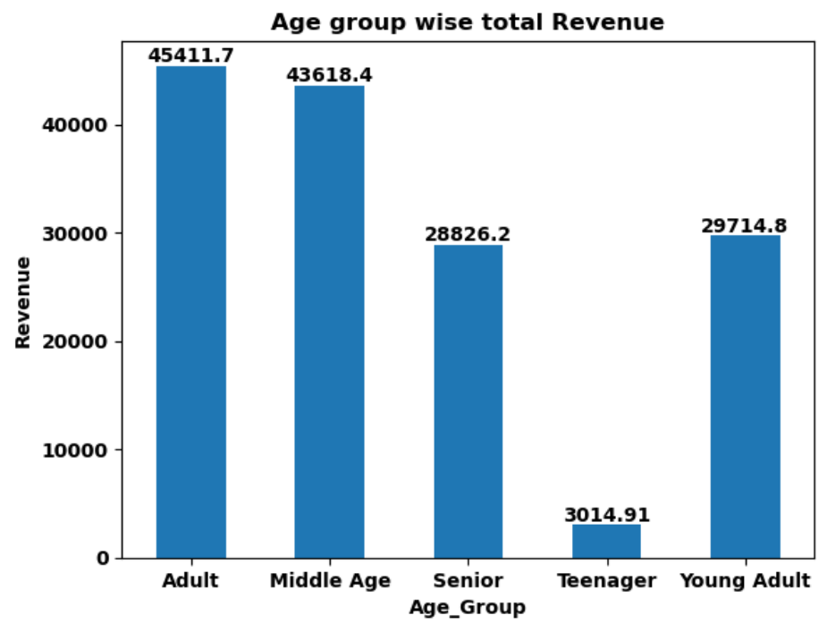
11. Age group wise total Revenue
Code :
v = df.groupby("Age_Group").Total_Spend.
sum().plot(kind = "bar")
for i in v.containers:
v.bar_label(i, fontweight ='bold’)
plt.title("Age group wise total Revenue",
fontweight = "bold")
plt.xticks(fontweight="bold",rotation=0)
plt.yticks(fontweight = 'bold')
plt.xlabel('Age_Group',fontweight = 'bold')
plt.ylabel('Revenue',fontweight = 'bold')
plt.show()
© All rights reserved by Fireblaze Technologies Pvt. Ltd.

Slide 17
Challenges Faced
It was challenging to clearly identify which customers were high-value vs. low-value.
The dataset needed preprocessing to group customers by spending, visits, and loyalty.
Measuring the impact of promotions and loyalty programs required careful comparison.
Customer feedback scores were limited and needed proper handling.
Segmenting customers using RFM analysis and interpreting the scores took effort.
Making clear and meaningful visualizations to explain customer behavior was time-consuming.
© All rights reserved by Fireblaze Technologies Pvt. Ltd.

Slide 18
Suggestions
Focus on loyal and high-value customers by giving them special offers.
The salon should maintain proper records of customers, visits, and spending.
Improve customer service based on feedback and satisfaction ratings.
Provide seasonal discounts or promotions to attract more visits.
Use simple dashboards or reports to track loyalty, spending, and promotions easily.
© All rights reserved by Fireblaze Technologies Pvt. Ltd.

Slide 19
Summary :
Hair Salon Customer Analysis
The goal is to analyze customer data (demographics, spending, visit frequency, loyalty, and feedback) to segment customers and provide actionable insights for the salon
Key Findings:
Most customers are
Medium Value³.
Haircut accounts for the highest total spend (29.0% of total spend by customer)
Occasional Visitors contribute the most to total spend (37%)
64% of customers are not in the Loyalty Program
The Adult age group generates the highest total revenue
.
© All rights reserved by Fireblaze Technologies Pvt. Ltd.

Slide 20
Conclusion
The Hair Salon Customer Analysis project helped me understand how to clean and analyze customer data. I learned to identify high-value and loyal customers, study visit frequency and spending patterns, and check how promotions and loyalty programs affect customer behavior.
This project showed how data analysis can solve real business problems, improve decision-making, and support salon owners in increasing revenue, customer satisfaction, and retention.
© All rights reserved by Fireblaze Technologies Pvt. Ltd.

Slide 21
Thank you
© All rights reserved by Fireblaze Technologies Pvt. Ltd.

